Slide 1
GSTREAMER PIPELINE ANALYSER
VIJAY VANGA

Slide 2
Topics:
Objective
Use case
Implementation
Flow chart
Future scope
2
© Copyright Softnautics (a MosChip Company), Confidential
13 sept, 2024

Slide 3
Objective:
Objective:
The objective of this code is to debug the pipeline logs and generate the pipeline flow graphical diagram.
3
© Copyright Softnautics (a MosChip Company), Confidential
13 sept, 2024

Slide 4
Use cases:
Usage:
1. By using this code, we can generate different pipeline logs.
2. By using this code, we can generate pipeline working flow
diagram.
4
© Copyright Softnautics (a MosChip Company), Confidential
13 sept, 2024

Slide 5
Implementation:
Create pipeline by using gstreamer framework api's .
This code implemeted by using linux environmental variables function to set the generated file path.
To genetate graph of the pipeline we need to pass some arguments to the predefined API by its macro.
By using this graphviz application convert the dot file to png image to verify the pipeline with graphical representation.
5
© Copyright Softnautics (a MosChip Company), Confidential
13 sept, 2024

Slide 6
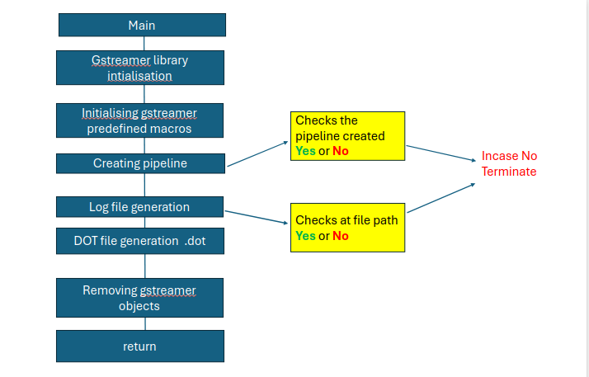
Flow chart of the pipeline analyser:
6
© Copyright Softnautics (a MosChip Company), Confidential
13 sept, 2024

Slide 7
Further extension of pipeline analyser:
1. We can also, able to generate latency files for Gstreamer pipelines .
2.Frame step information can be obtained.
3.In future we can generate multiple log files simultaneously.
7
© Copyright Softnautics (a MosChip Company), Confidential
13 sept, 2024

Slide 8
© Copyright Softnautics (a MosChip Company), Confidential
13 sept, 2024

